Slide 1
Data analysis project-1
By Noah Shanthi Raj

Slide 2
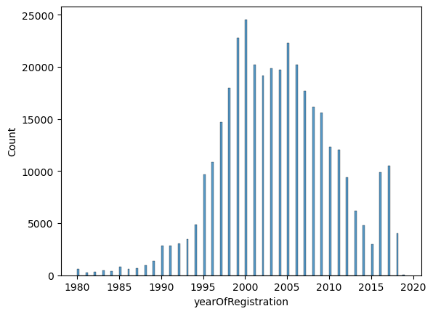
On the plot there is a spike from the year 1995 with the top sale around 24000 vehicles in the year 2000

Slide 3
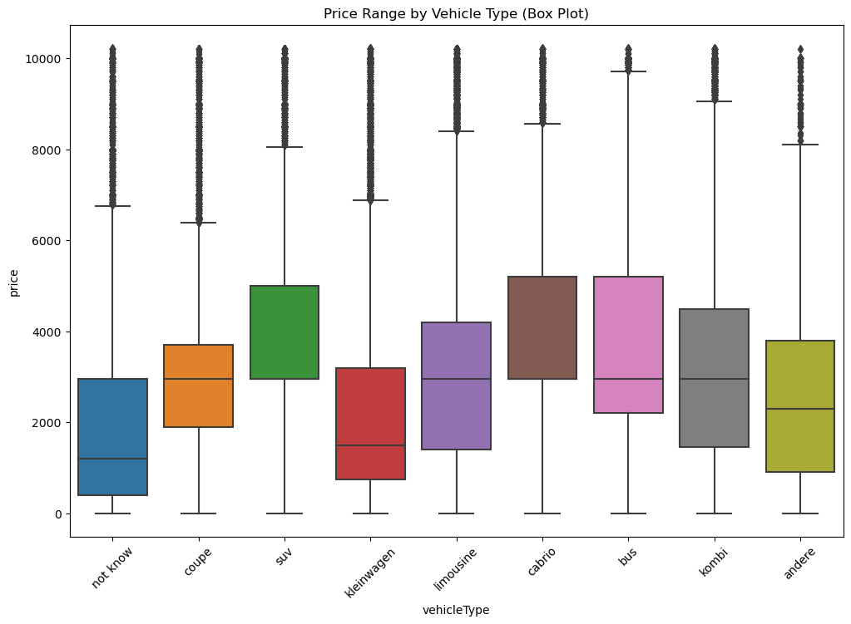
Less wider outliers is seen is bus vehicle type and all vehicle types have outliers

Slide 4
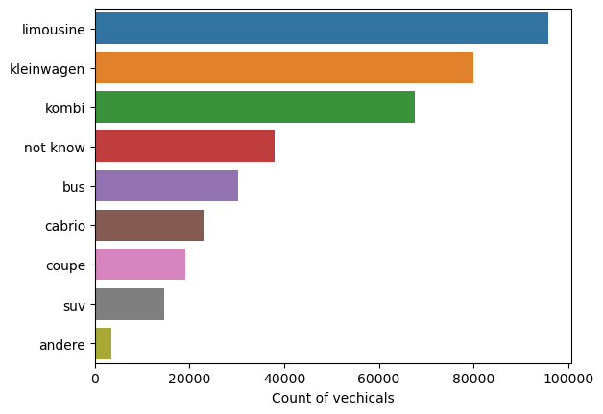
Limosine has highest count of vehicles and andere the least count in vehicle type

Slide 5
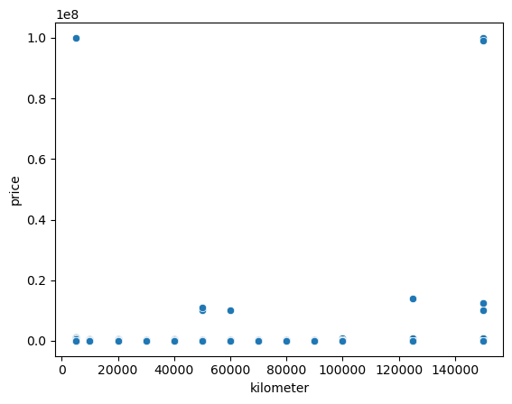
We can see in scatter plot the is no relation between dollar price(without dealing outliers) and kilometre

Slide 6
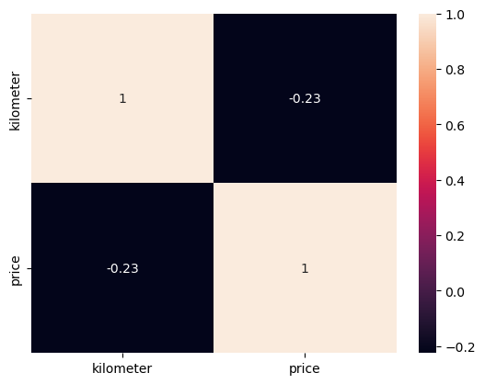
Applying spearman rank corelation we can see there is weak negative monotonic relationship between in relation between dollar price and kilometre

Slide 7
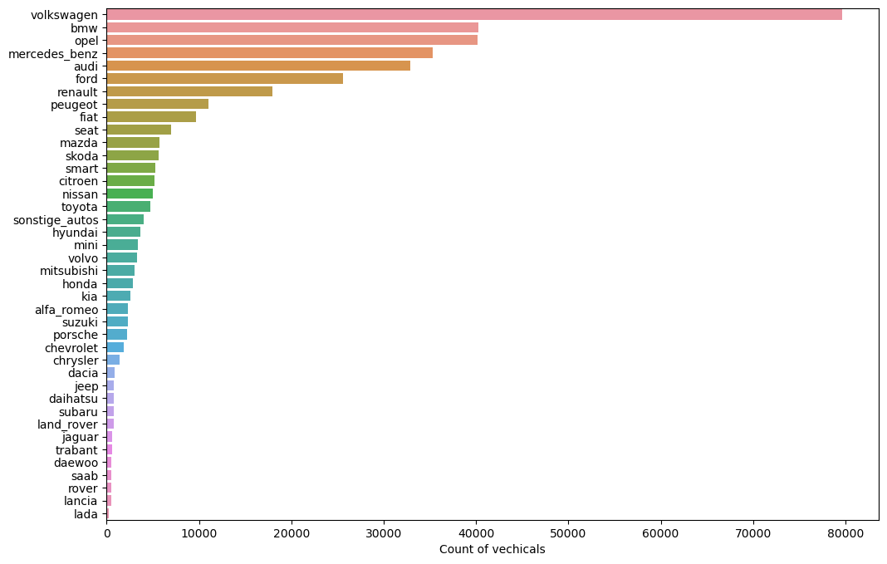
volkswagen 79640 and bmw 40274 takes 1st and 2nd postion with respective values

Slide 8
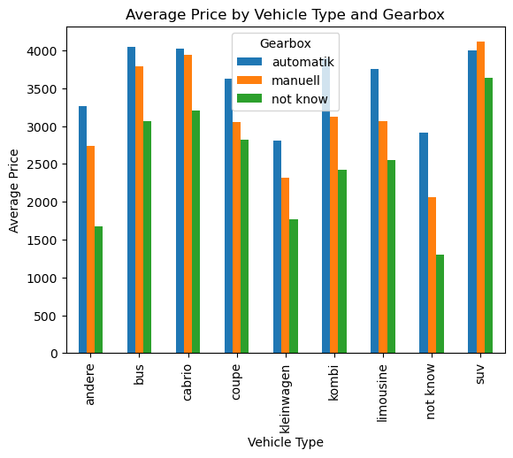
Suv, cabrio, bus is expensive vehicle types with less regard to gearbox. Average starting price for the most of vehicles is around $2000. kombi, limousine have observable price variation with regards to gearbox

Slide 9
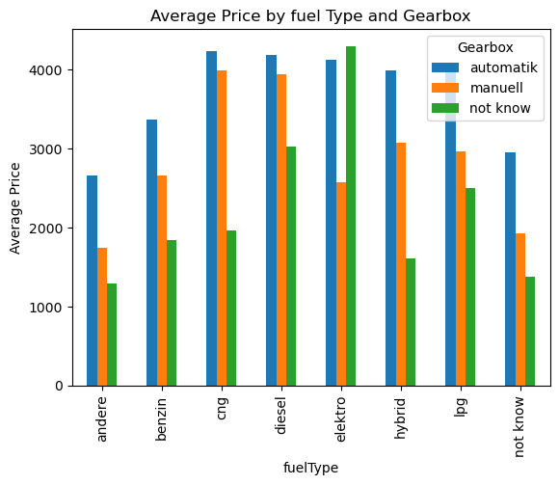
cng fuel type and automatik gearbox is having the highest average price and diseal and elektro fuel type with automatic gearbox are some in top list. elektro has major average price variation with regards to gearbox. Cng and diesel has not much difference In average price in regards to gearbox

Slide 10
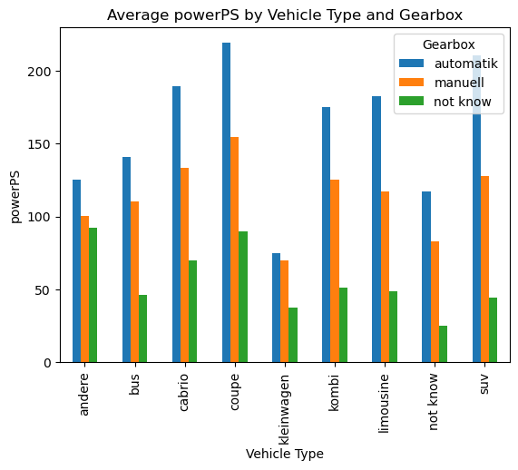
coupe vehicle type with automatic gearbox have the highest average price and most vehicles have power above 100. least variation with gearbox is seen in andere and bus in regards to average power

Slide 11
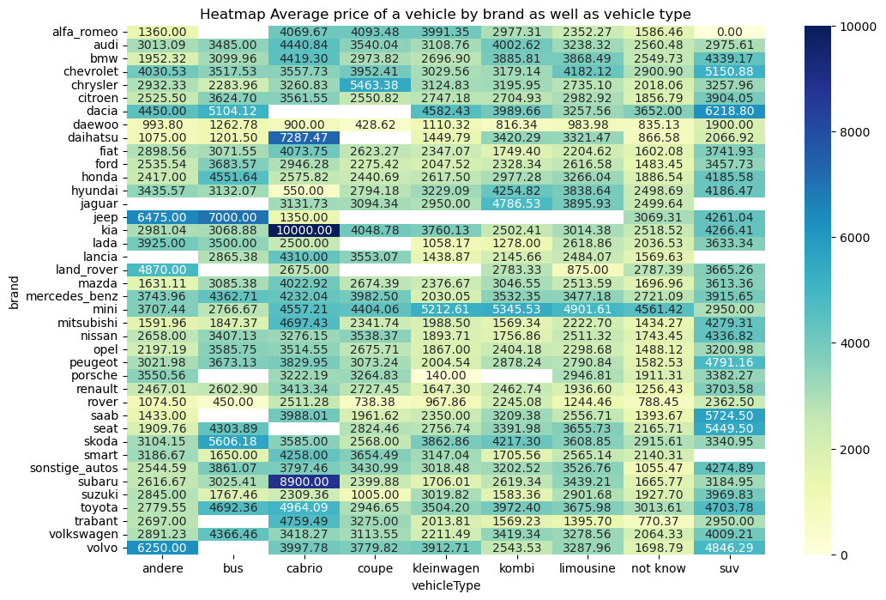
Kia brand of cabrio vehicle type have a average price of 10000, followed by Subaru brand of cabrio vehicle type. Most highest average price is seen in cabrio and suv vehicle type

